Slide 1
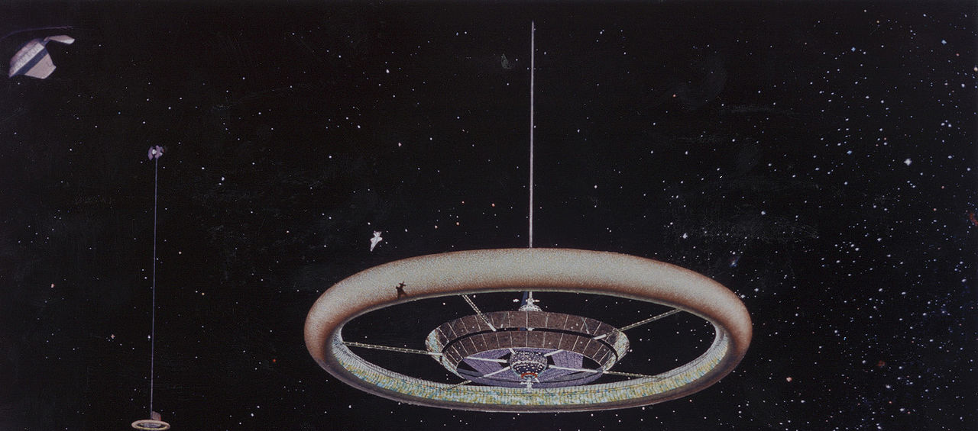
Orbital Mechanics Equations
Dr. Joseph Iannelli
Professor of Mechanical Engineering
WSU - Voiland College of Engineering and Architecture

Slide 2
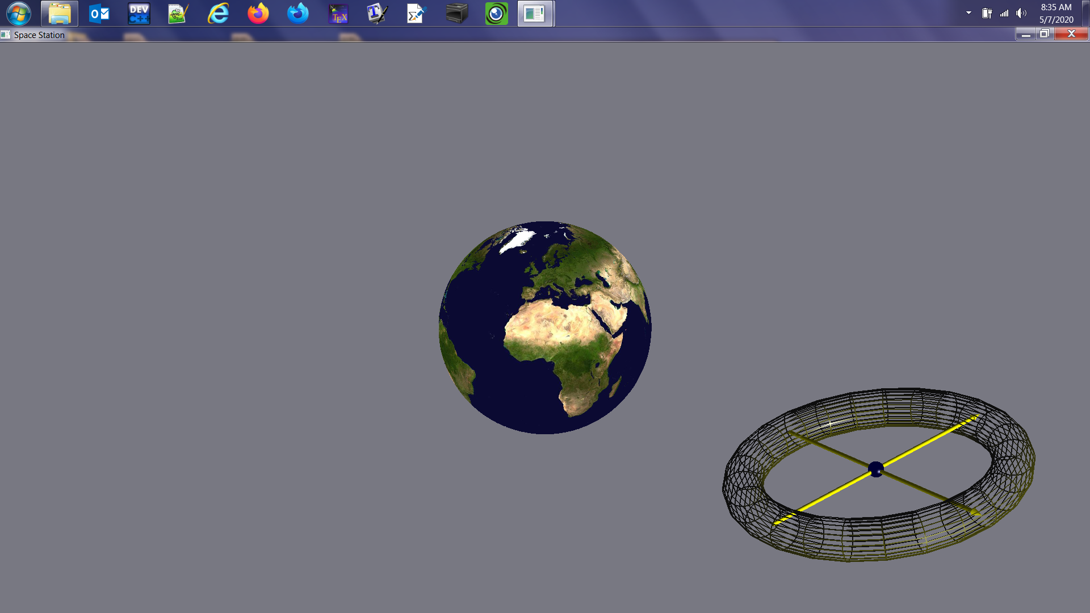
Objective
Modeling the motion of a rigid body
Around the Earth

Slide 3
Methods
Derivation and Computational Solution of the Equations of 2 Motions:
Curvilinear Motion of G on Orbit Around the Earth
Rigid-Body Rotation about G
Equations in Non-Dimensional Form
Asymmetry in Mass Distribution
Numerical Solution of Equations
via C++ Computer Program
Different Initial Conditions
G

Slide 4
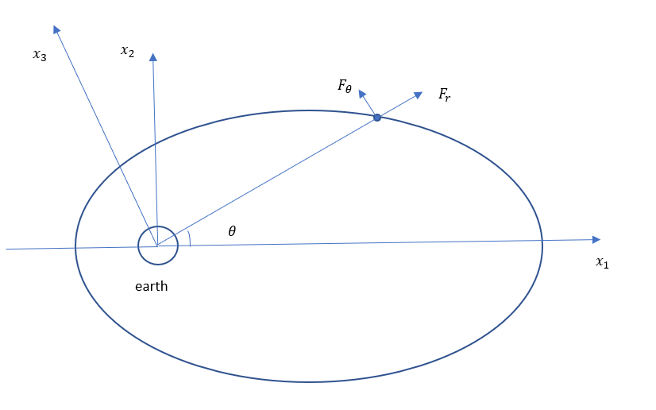

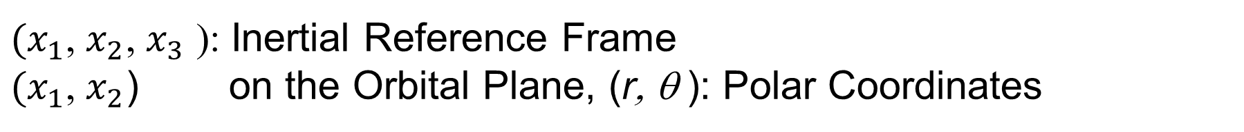
Derivation of The Equations of Motion Curvilinear Motion of G on Orbit Around the Earth
2nd Law of Newtonian Mechanics: $\sum{F} =m a_{G}$
${(x}_{1}$, $x_{2}$, $x_{3}$ ): Inertial Reference Frame
${(x}_{1}$, $x_{2}$) on the Orbital Plane, (r, θ ): Polar Coordinates
G
Force of gravity:
$F_{r}=\frac{−GMm}{r^{2}}$
r

Slide 5
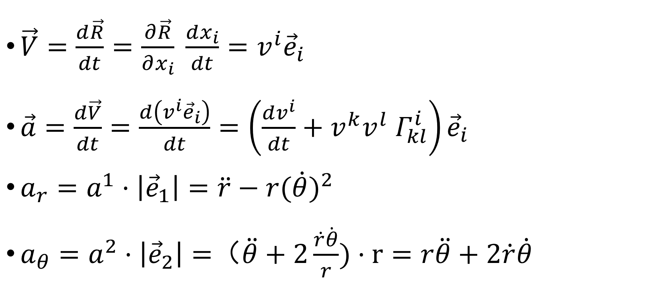
Tensor Derivation of the Acceleration of G
$\vec{V}=\frac{d\vec{R}}{dt}=\frac{∂\vec{R}}{∂x_{i}} \frac{dx_{i}}{dt}=v^{i}{\vec{e}}_{i}$
$\vec{a}=\frac{d\vec{V}}{dt}=\frac{d\left(v^{i}{\vec{e}}_{i}\right)}{dt}=\left(\frac{dv^{i}}{dt}+v^{k}v^{l}{ Γ}_{kl}^{i}\right){\vec{e}}_{i}$
$a_{r}=a^{1}·\left|{\vec{e}}_{1}\right|=\ddot{r}−r{(\dot{θ})}^{2}$
$a_{θ}=a^{2}·\left|{\vec{e}}_{2}\right|=$（$\ddot{θ}+2\frac{\dot{r}\dot{θ}}{r})·r=r\ddot{θ}+2\dot{r}\dot{θ}$

Slide 6
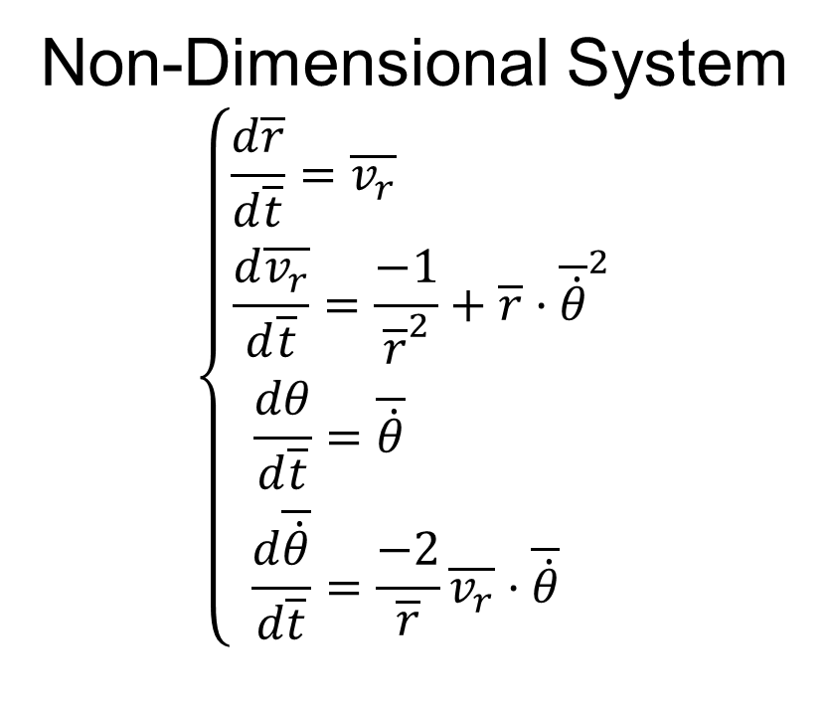

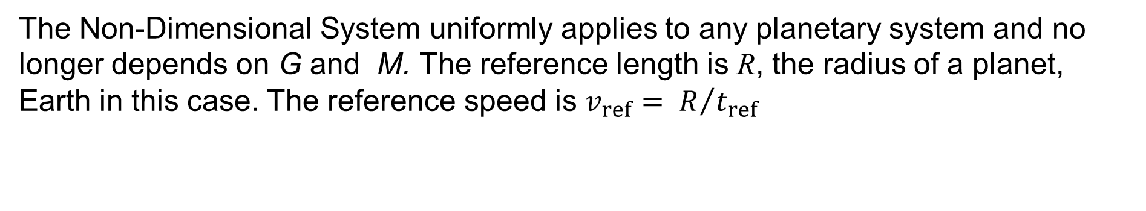

Radial and Transverse Components of 2nd Law:
Four 1st-Order Non-Linear Equations of Motion
Dimensional System
$$\left\{\begin{aligned}\frac{dr}{dt}=v_{r} \left(1\right) \\ \frac{{dv}_{r}}{dt}=\frac{−GM}{r^{2}}+r{\dot{θ}}^{2} \left(2\right) \\ \frac{dθ}{dt}=\dot{θ} \left(3\right) \\ \frac{d\dot{θ}}{dt}=\frac{−2}{r}v_{r}·\dot{θ} (4) \end{aligned}\right.$$
Non-Dimensional System
$$\left\{\begin{aligned}\frac{d\overline{r}}{d\overline{t}}=\overline{v_{r}} \\ \frac{d\overline{v_{r}}}{d\overline{t}}=\frac{−1}{{\overline{r}}^{2}}+\overline{r}·{\overline{\dot{θ}}}^{2} \\ \frac{dθ}{d\overline{t}}=\overline{\dot{θ}} \\ \frac{d\overline{\dot{θ}}}{d\overline{t}}=\frac{−2}{\overline{r}}\overline{v_{r}}·\overline{\dot{θ}} \end{aligned}\right.$$
$$\left\{ \begin{aligned}&r=R·\overline{r} \\ &t=t_{ref}·\overline{t} \\ &t_{ref}=\sqrt{\frac{R^{3}}{GM}} \\ &\dot{θ}= \frac{1}{t_{ref}}·\overline{\dot{θ}}\end{aligned}\right.$$
→
The Non-Dimensional System uniformly applies to any planetary system and no longer depends on G and M. The reference length is R, the radius of a planet, Earth in this case. The reference speed is $v_{ref}= R/{t_{ref}}$

Slide 7
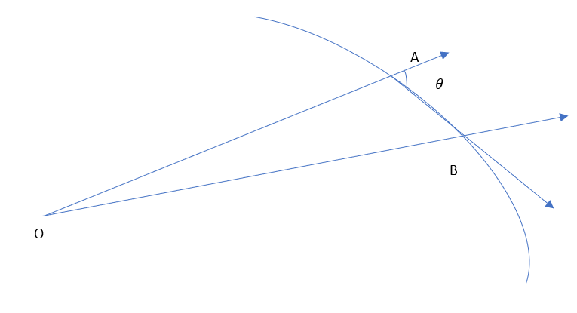
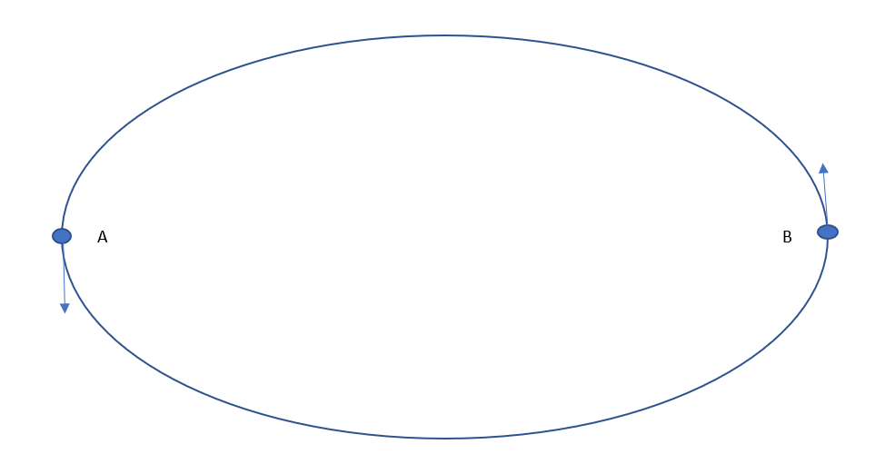
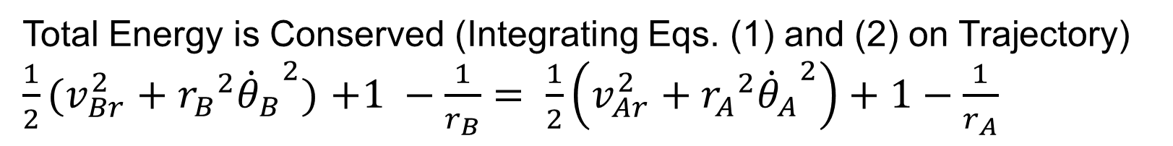
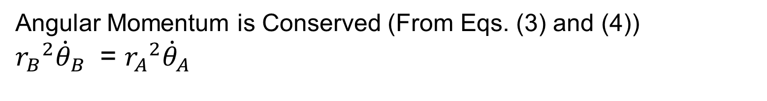
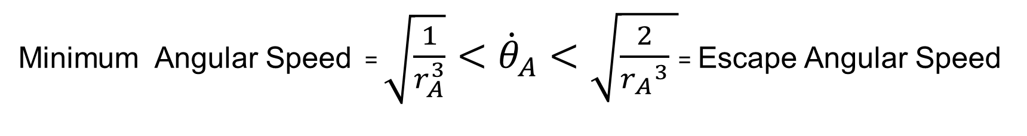
Minimum and Maximum Orbital Angular Speeds Gravitational Field is Radial & Conservative
Angular Momentum is Conserved (From Eqs. (3) and (4))
${r_{B}}^{2}{{\dot{θ}}_{B}}^{ }$ = ${r_{A}}^{2}{{\dot{θ}}_{A}}^{ }$
Total Energy is Conserved (Integrating Eqs. (1) and (2) on Trajectory)
$\frac{1}{2}(v_{Br}^{2}+{r_{B}}^{2}{{\dot{θ}}_{B}}^{2})$ $+1 −\frac{1}{r_{B}}= \frac{1}{2}\left(v_{Ar}^{2}+{r_{A}}^{2}{{\dot{θ}}_{A}}^{2}\right)+1−\frac{1}{r_{A}}$
Minimum Angular Speed = $\sqrt{\frac{1}{r_{A}^{3}}}<{\dot{θ}}_{A}<\sqrt{\frac{2}{{r_{A}}^{3}} }$= Escape Angular Speed
for Circular Orbit, $r_{B}$ -> $r_{A}$ for $r_{B}$ -> ∞
Needed for Initial Conditions

Slide 8





Derivation of The Equations of Motion Rigid Body Rotation About G
$x_{3b}$
Euler Equations with respect to
${(x}_{1b}$, $x_{2b}$, $x_{3b}$ ) Body Axes
$x_{2b}$
$$\left\{\begin{aligned}\dot{ω_{1}}+（\frac{I_{3}−I_{2}}{I_{1}}）ω_{2}ω_{3}=\frac{M_{1} }{I_{1}} \\ \dot{ω_{2}}+（\frac{I_{1}−I_{3}}{I_{2}}）ω_{3}ω_{1}=\frac{M_{2} }{I_{2}} \\ \dot{ω_{3}}+（\frac{I_{2}−I_{1}}{I_{3}}）ω_{1}ω_{2}=\frac{M_{3} }{I_{3}}\end{aligned}\right.$$
G
G
$x_{1b}$
$I_{1}$ , $I_{2}$, $I_{3}$ : Mass Moments of Inertia - $I_{2}>$ $I_{1}$ For Mass Asymmetry
$M_{1}$ , $M_{2}$, $M_{3}$ : Components of External Torques in body axes

Slide 9



















Transformation Between Inertial and Body Axes
$x_{3a}$
$x_{3}$
$$ψ$$
$$β$$
${(x}_{1}$, ${ x}_{2}$, ${ x}_{3}$ ): Inertial Axes
${(x}_{1b}$, $x_{2b}$, $x_{3b}$ ): Body Axes
$x_{3b}$
$x_{2b}$
$$φ$$
( $β$, $ψ$, $φ$ ): Euler Angles:
Sequential Rotations about these
Axes: ${(x}_{1}$, ${ x}_{2a}$, ${ x}_{3b}$ )
$x_{2a}$
$$β$$
$$φ$$
$x_{2}$
$$ψ$$
Transformation Law:
$${ F}_{Body}=BCD F_{Inertial}$$
$x_{1b}$
$x_{1}$
$x_{1a}$
Transformation Matrices
B=$\left(\begin{aligned}cosφ sinφ 0 \\ −sinφ cosφ 0 \\ 0 0 1\end{aligned}\right)$; C=$\left(\begin{aligned}cosψ 0 −sinψ \\ 0 1 0 \\ sinψ 0 cosψ\end{aligned}\right)$; D=$\left(\begin{aligned}1 0 0 \\ 0 cosβ sinβ \\ 0 −sinβ cosβ\end{aligned}\right)$

Slide 10
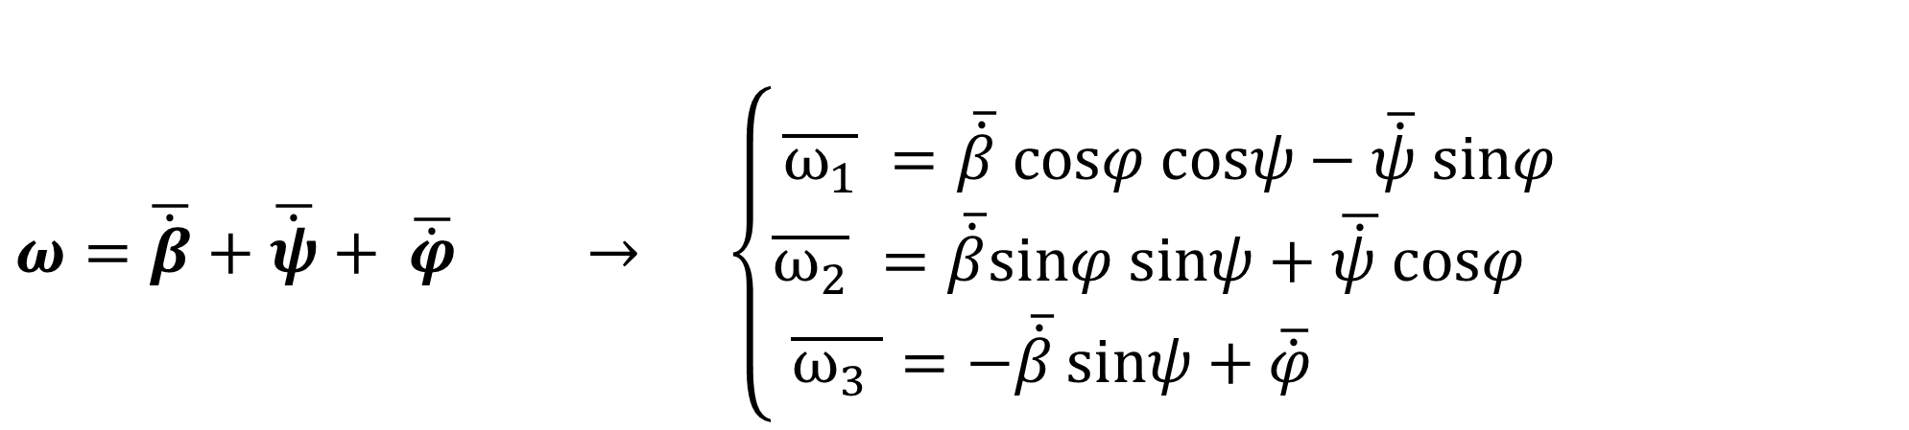
Angular Speed Components in Body Axes
$$ω=\overline{\dot{β}}+\overline{\dot{ψ}}+ \overline{\dot{φ}} → \left\{\begin{aligned}\overline{ω_{1}} =\overline{\dot{β}} cosφ cosψ−\overline{\dot{ψ}} sinφ \\ \overline{ω_{2}} =\overline{\dot{β}}sinφ sinψ+\overline{\dot{ψ }}cosφ \\ \overline{ω_{3} }=−\overline{\dot{β}}sinψ+\overline{\dot{φ}}{ }\end{aligned}\right.$$

Slide 11
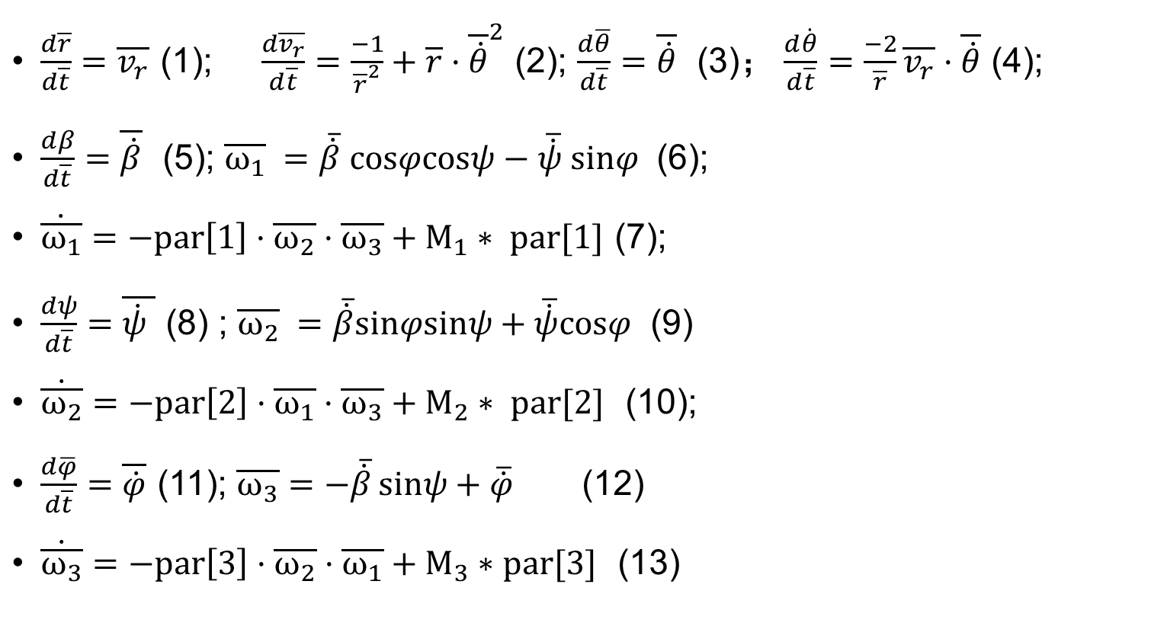

Complete Set of 13 Equations of Motion Computationally Solved via C++ Code
$\frac{d\overline{r}}{d\overline{t}}=\overline{v_{r}}$ (1); $\frac{d\overline{v_{r}}}{d\overline{t}}=\frac{−1}{{\overline{r}}^{2}}+\overline{r}·{\overline{\dot{θ}}}^{2}$ (2); $\frac{d\overline{θ}}{d\overline{t}}=\overline{\dot{θ}}$ (3)； $\frac{d\dot{θ}}{d\overline{t}}=\frac{−2}{\overline{r}}\overline{v_{r}}·\overline{\dot{θ}}$ (4);
$\frac{dβ}{d\overline{t}}=\overline{\dot{β}}$ (5); $\overline{ω_{1}} =\overline{\dot{β}} cosφcosψ−\overline{\dot{ψ}} sinφ$ (6);
$\dot{\overline{ω_{1}}}=−par\left[1\right]·\overline{ω_{2}}·\overline{ω_{3}}+M_{1}∗ par[1]$ (7);
$\frac{dψ}{d\overline{t}}=\overline{\dot{ψ} }$ (8) ; $\overline{ω_{2}} =\overline{\dot{β}}sinφsinψ+\overline{\dot{ψ}}cosφ$ (9)
$\dot{\overline{ω_{2}}}=−par\left[2\right]·\overline{ω_{1}}·\overline{ω_{3}}+M_{2}∗ par[2]$ (10);
$\frac{d\overline{φ}}{d\overline{t}}=\overline{\dot{φ}}$ (11); $\overline{ω_{3}}=−\overline{\dot{β}}sinψ+\overline{\dot{φ}}{ }$(12)
$\dot{\overline{ω_{3}}}=−par\left[3\right]·\overline{ω_{2}}·\overline{ω_{1}}+M_{3}∗par[3]$ (13)
The parameters are set as:
$$par\left[1\right]=（\frac{I_{3}−I_{2}}{I_{1}}）;$$
$$par\left[2\right]=（\frac{I_{1}−I_{3}}{I_{2}}）;$$
$$par\left[3\right]=（\frac{I_{2}−I_{1}}{I_{3}}）;$$

Slide 12
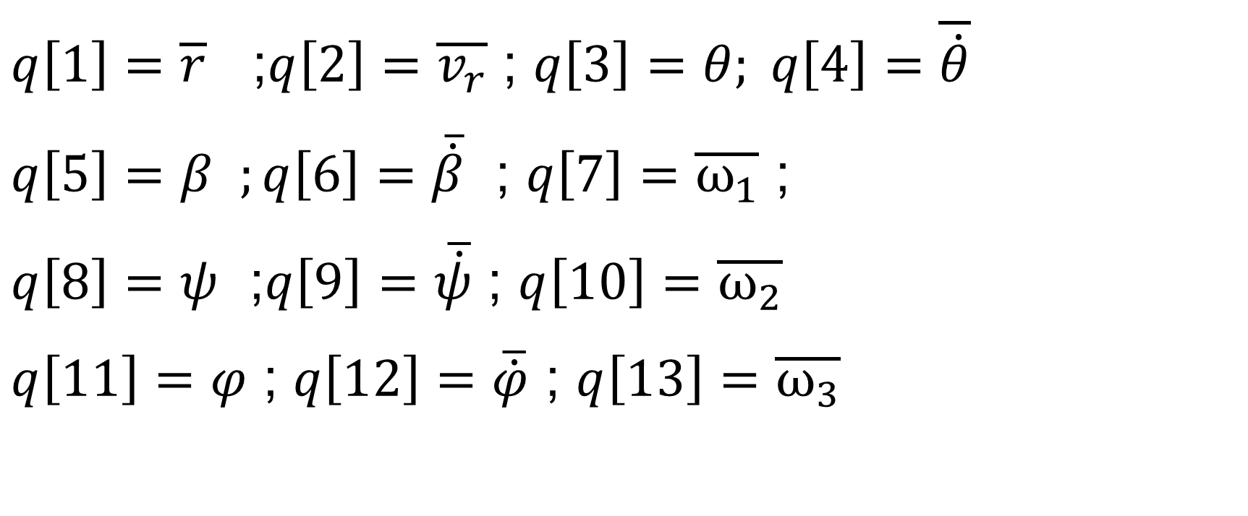
Computational Solution Expressed in Terms of Time Variations of the Following 13 Variables
$q\left[1\right]=\overline{r}$ ;$q\left[2\right]=\overline{v_{r}}$ ; $q\left[3\right]=θ; q\left[4\right]=\overline{\dot{θ}}$
$q\left[5\right]=$ $β ;q\left[6\right]=\overline{\dot{β}}$ ; $q\left[7\right]=\overline{ω_{1}}$ ;
$q\left[8\right]=ψ$ ;$q\left[9\right]=\overline{\dot{ψ}}$ ; $q\left[10\right]=\overline{ω_{2}}$
$q\left[11\right]=φ$ ; $q\left[12\right]=\overline{\dot{φ}}$ ; $q\left[13\right]=\overline{ω_{3}}$

